Slide 1

Industrial Automation Project
System Architecture
Index no – 190524T
Name – Ravinaths.

Slide 2
Introduction
This project make familiarize with tkinter library and esp32 board
Creating a GUI for IOT application to control fan manual and automatic.
Data collection.
Remote control and Monitoring.
Enhanced user Experience.

Slide 3
Problem description
This project aimed at creating GUI to control a fan.
It works in two modes manual and auto mode.
In manual mode case fan will be ON when switch on and fan off when switch off.
In auto mode case when temperature read from DHT 11 sensor exceed the threshold value fan should ON.
When lower than temperature fan goes OFF.
Maintaining a record

Slide 4
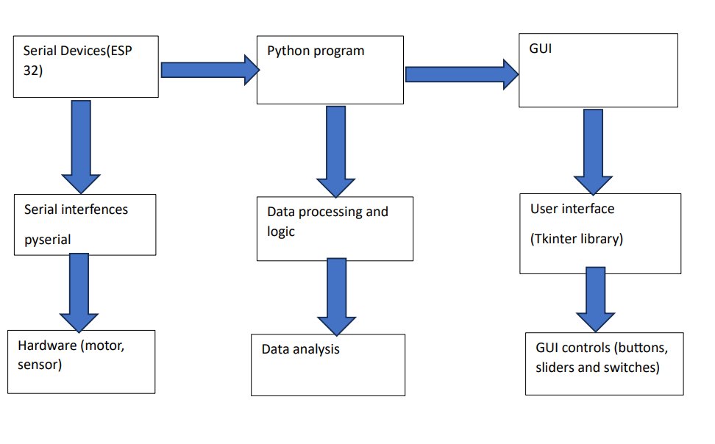
System Architecture

Slide 5
Selected Hardware and Software:
Software used
Python
Arduino idle
Hardware
ESP 32 WROOM
DHT 11 sensor
Relay
Motor
Fan
Jumper wires and bread board

Slide 6
About
Explanation of the serial library for serial communication.
Configuration of the serial port (COM13) with a baud rate of 115200.
Timeout set to 1 second for efficient data handling.
Library used
Custom tkinter - create GUI
Pandas- To create data log
pyserial – to have serial communication
Serial Connection
COM13 port and baud rate 115200 used for serial communication with board.

Slide 7
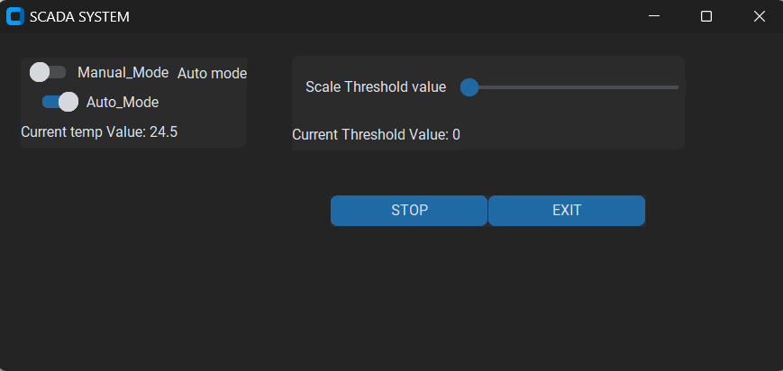
GUI setup
Explanation of the serial library for serial communication.
Configuration of the serial port (COM13) with a baud rate of 115200.
Timeout set to 1 second for efficient data handling.
GUI interface created using custom tkinter library in python.
Buttons, labels, scalers and buttons used to facilitate the purpose.

Slide 8
Manual mode
Explanation of the serial library for serial communication.
Configuration of the serial port (COM13) with a baud rate of 115200.
Timeout set to 1 second for efficient data handling.
To do this, I used a switch then switch.get(), to make 1 and 0 to used in my code.
def Fan_ON(switch_ON):
if switch_ON.get() == 1:
print("Fan=ON")
ser.write(b"A")
if switch_ON.get() == 0:
print("Fan=OFF")
ser.write(b"B")

Slide 9
Auto mode
Explanation of the serial library for serial communication.
Configuration of the serial port (COM13) with a baud rate of 115200.
Timeout set to 1 second for efficient data handling.
Need to set a threshold value and then compare with sensor data.
I used a scaler function to set threshold value and to read sensor data I use the serial communication.
if threshold_value < temp_value:
print("Fan-ON")
fan_status = "Fan-ON"
ser.write(b"A")
else :
fan_status="Fan-OFF"
print("Fan-OFF")
ser.write(b"B")

Slide 10
Sensor data read
Explanation of the serial library for serial communication.
Configuration of the serial port (COM13) with a baud rate of 115200.
Timeout set to 1 second for efficient data handling.
First i check data is there in sensor then we only need temperature value
Get only temperature value.
Then assigned to global variable to use for the project.

Slide 11
Data logging
Explanation of the serial library for serial communication.
Configuration of the serial port (COM13) with a baud rate of 115200.
Timeout set to 1 second for efficient data handling.
I have used a Excel file to save data of sensor values, fan on/off status, manual/auto modes and time.
Created a data frame to store processing data and then add all to excel sheet.

Slide 12
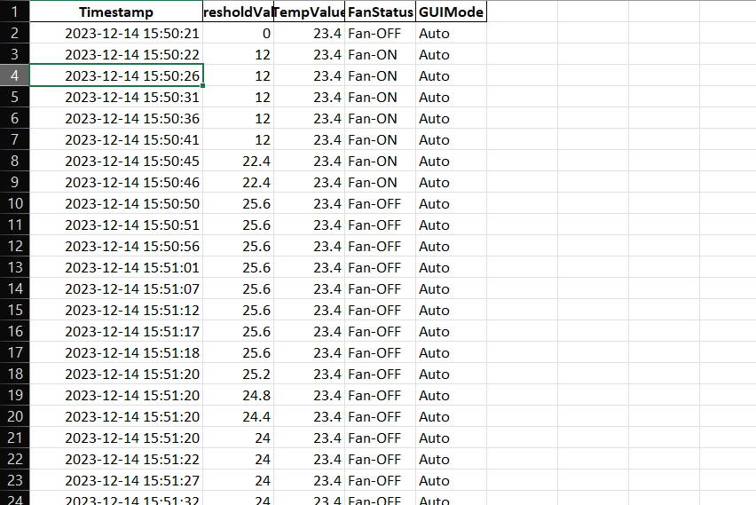
Data logging
Explanation of the serial library for serial communication.
Configuration of the serial port (COM13) with a baud rate of 115200.
Timeout set to 1 second for efficient data handling.

Slide 13
Thank YoU
Explanation of the serial library for serial communication.
Configuration of the serial port (COM13) with a baud rate of 115200.
Timeout set to 1 second for efficient data handling.

